Slide 1
BERT Visualization
Xueren Ge
Haibei Zhu

Slide 2
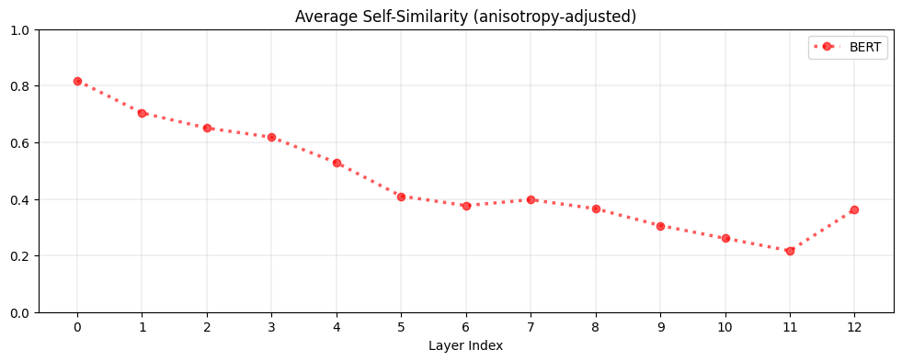
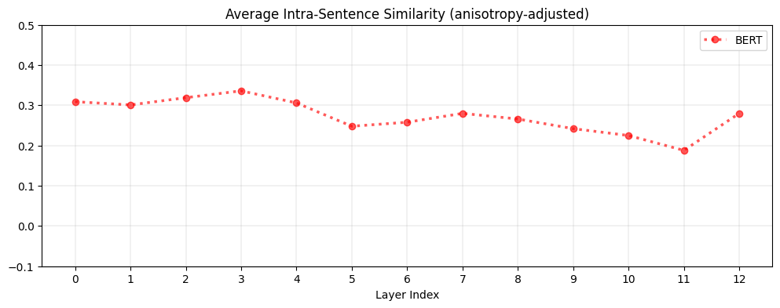
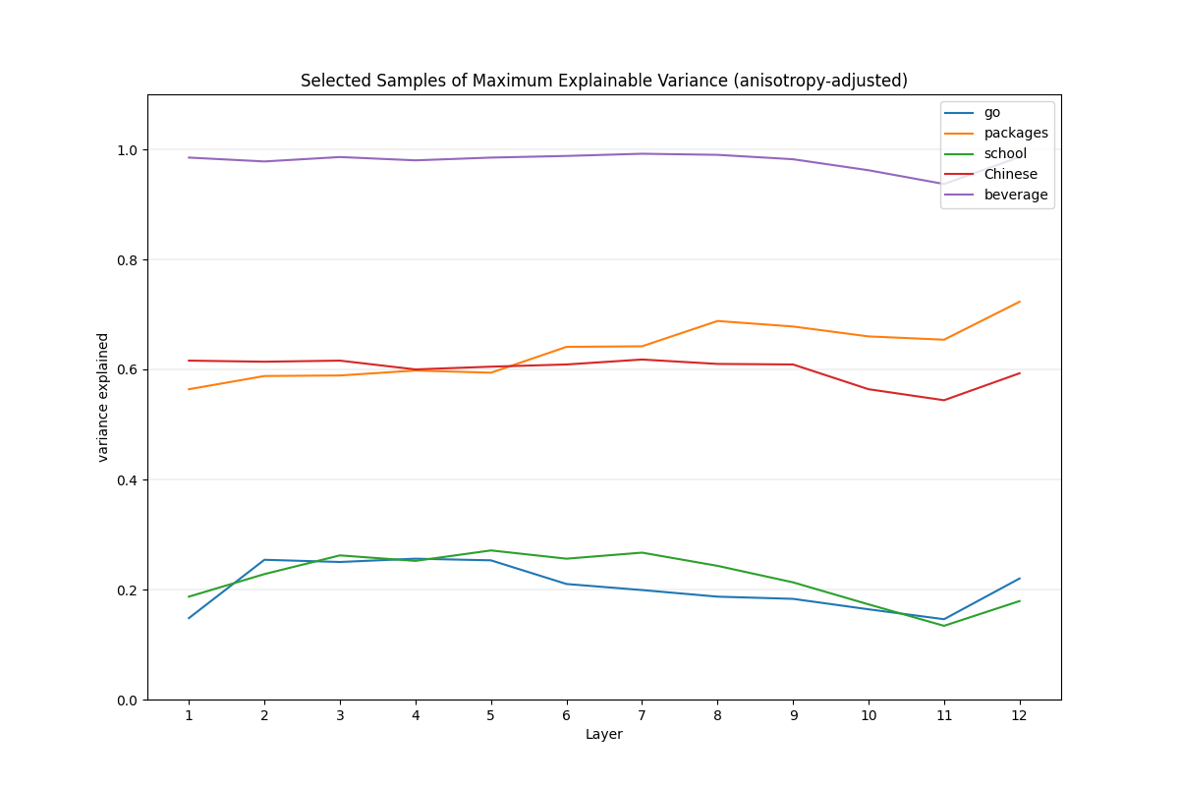
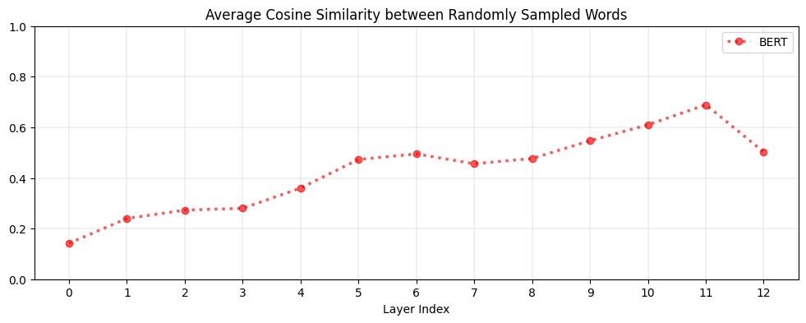
Metrics & Results
Dataset: Stanford Natural Language Inference (SNLI) Corpus
Self-similarity
Intra-Sentence similarity
The higher the layer, the lower the self-similarity, suggesting contextualized word representations are more context-specific in higher layers.
As layer goes deeper, the lower Intra-sentence similarity →
2 words don’t have same meaning even when they share the same context.
Anisotropy
Maximum explainable variance
Any 2 random words have similar representation, which means,
the whole vector space tend to be a cone instead of ball.
’beverage’ is almost 1, which means in all context , in all layers its meaning
is almost the same. And can be replaced by static embedding.
How Contextual are Contextualized Word Representations? Comparing the Geometry of BERT, ELMo, and GPT-2 Embeddings

Slide 3
Future Goal
Tackle “Anisotropy” problem within BERT
How to visualize anisotropy problem (done)
How to solve anisotropy problem (contrastive learning)
Understand why BERT work
Does BERT really learn contextual information? (yes!)
The importance of each layer in BERT (Hugging Face)
How to build better BERT
Structure
Dataset
Future Work
Data-biased
Inspired by Last class ethics, we planned to change the data distribution, let it be biased-dataset, and see what Bert will learns and what’s going on in each layer
Structure
We have seen layer 12 may have bad performances, we planned to use Hugging Face to froze some layers to see what Bert will react.
Anisotropy
Maybe use contrastive learning to see how to solve this problem
How Contextual are Contextualized Word Representations? Comparing the Geometry of BERT, ELMo, and GPT-2 Embeddings
https://aclanthology.org/D19-1006.pdf

